Slide 1


B.Tech CS KCS301 - Data Structure
KIET Group of Institutions, Delhi-NCR Ghaziabad
affiliated to DR. APJ Abdul Kalam Technical University, Lucknow
Lecture – 27 Iteration and Recursion
By
Harsh Khatter
Assistant Professor
Department of Computer Science

Slide 2
RECAP
Types of Queue
Simple
Circular
Double Ended
Priority
Advantages and Disadvantages of each

Slide 3
Today’s Content
Need of Iteration
Working with Iteration
Principles of recursion,
Tail recursion
Why Recursion (Time/Space Tradeoff)
Removal of recursion

Slide 4
Need of Iteration
To repeatedly executing the task
Print names of the students
Add the sum of values
Fetch values of list items
Many more

Slide 5
Iteration and Recursion
The Recursion and Iteration both repeatedly execute the set of instructions.
The iteration is when a loop repeatedly executes until the controlling condition becomes false.
Recursion is when a statement in a function calls itself repeatedly.

Slide 6
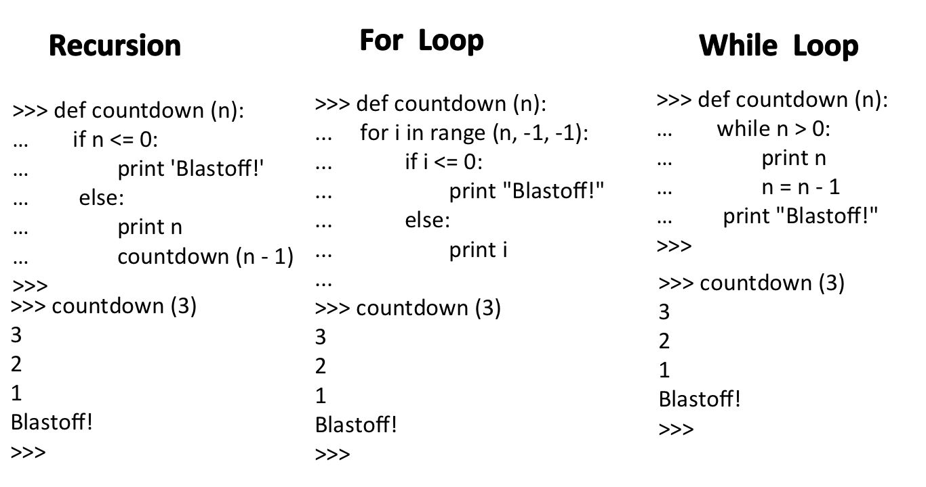
Let’s have a look to a scenario
To print a countdown
5.4.3.2.1…

Slide 7
Let’s have a look to a scenario
To print a countdown
5.4.3.2.1…

Slide 10
Iteration
Iteration uses repetition structure.
An infinite loop occurs with iteration if the loop condition test never becomes false and Infinite looping uses CPU cycles repeatedly.
An iteration terminates when the loop condition fails.
Iteration consumes less memory.
Iteration makes the code longer

Slide 11
Recursion
Recursion uses selection structure.
Infinite recursion occurs if the recursion step does not reduce the problem in a manner that converges on some condition (base case) and Infinite recursion can crash the system.
Recursion terminates when a base case is recognized.
Recursion is usually slower than iteration due to the overhead of maintaining the stack.
Recursion makes the code smaller.
Recursion uses more memory than iteration.

Slide 12
Role of Stack ???
Recursion is usually slower than iteration due to the overhead of maintaining the stack.
An iteration does not use the stack so it's faster than recursion.

Slide 13
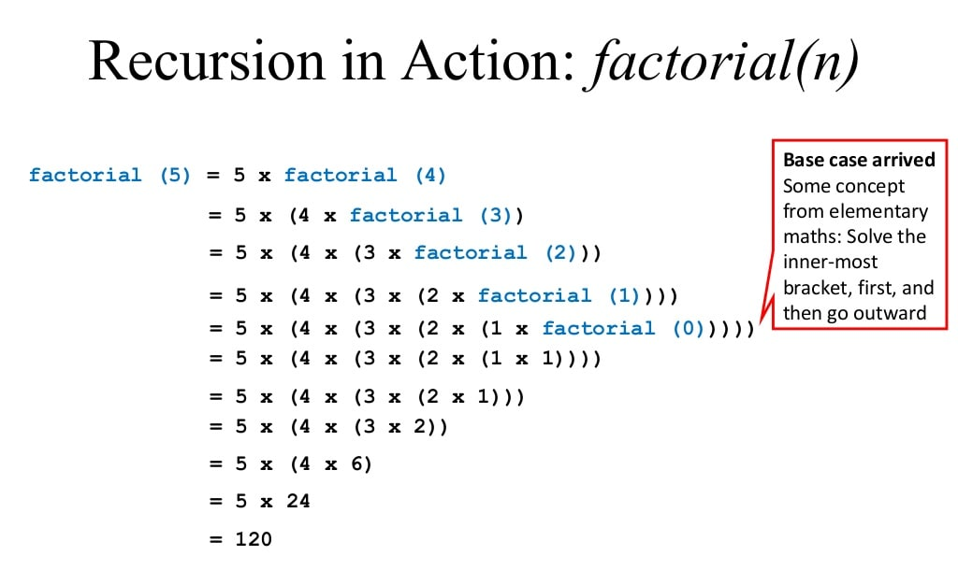

Slide 14
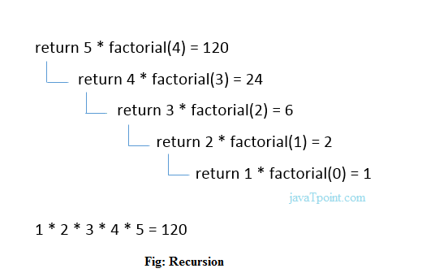
Recursion: Factorial

Slide 15
Where to apply Recursion
When Bigger problem can be divided into similar smaller (sub) problems
Keep on dividing until we reach to the smallest sub problem (BASE CASE) for which the solution is easy to find or known.

Slide 16
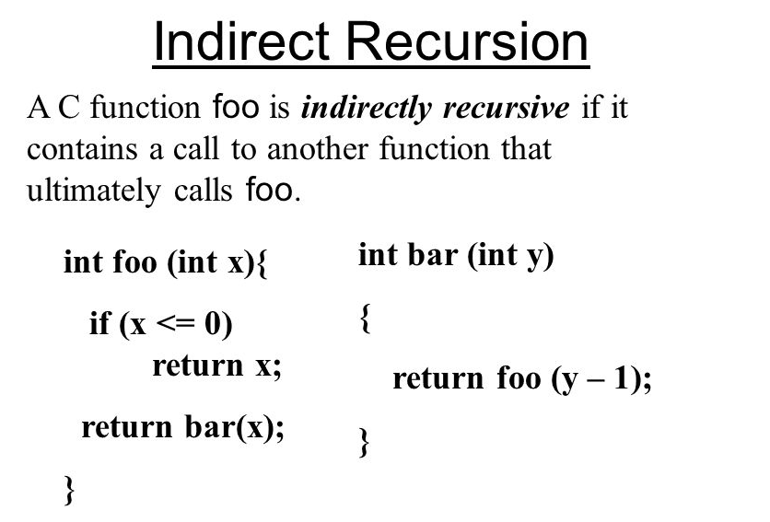
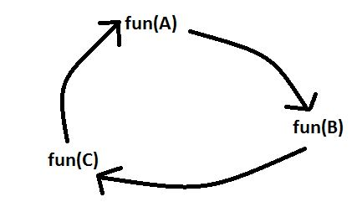
Types of Recursion
Linear/Direct Recursion:
A function calls itself from within itself.
Indirect Recursion:
A function calls itself from more than one function call one another mutually.

Slide 17
Types of Recursion
Tail Recursion:
A recursive function is called the tail-recursive if the function makes recursive calling itself, and that recursive call is the last statement executes by the function.
After that, there is no function or statement is left to call the recursive function.

Slide 18
Types of Recursion
4. Non Tail/ Head Recursion:
The recursive call will be the first statement in the function.
It means there should be no statement or operation is called before the recursive calls.
The head recursive does not perform any operation at the time of recursive calling.
Instead, all operations are done at the return time.

Slide 19
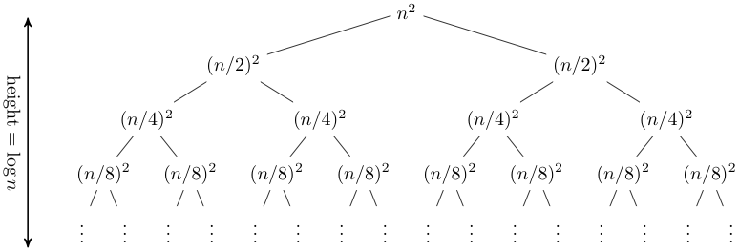
Types of Recursion
5. Tree Recursion:
The recursive call in the function is in parts: Left & Right
rec(n-1), rec(n+1)

Slide 20
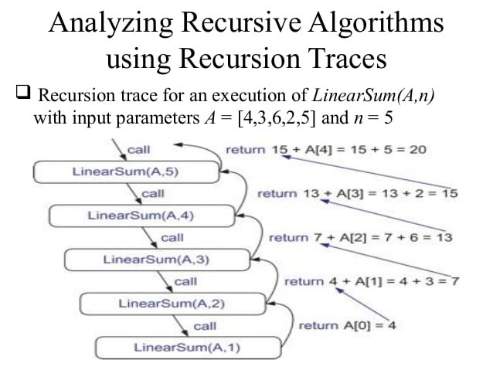

Slide 21
Session Outcome
Student is able to:
Understand the concept of Recursion
Know the steps involved in Recursion
Analyze the iterative and recursive approach
How recursion is using Stack
Understand the types of recursion

Slide 22
THANK YOU
Next Lecture – 28 Recursion Examples
Scenario Based Problems
Harsh Khatter
Assistant Professor
Department of Computer Science

